Slide 1
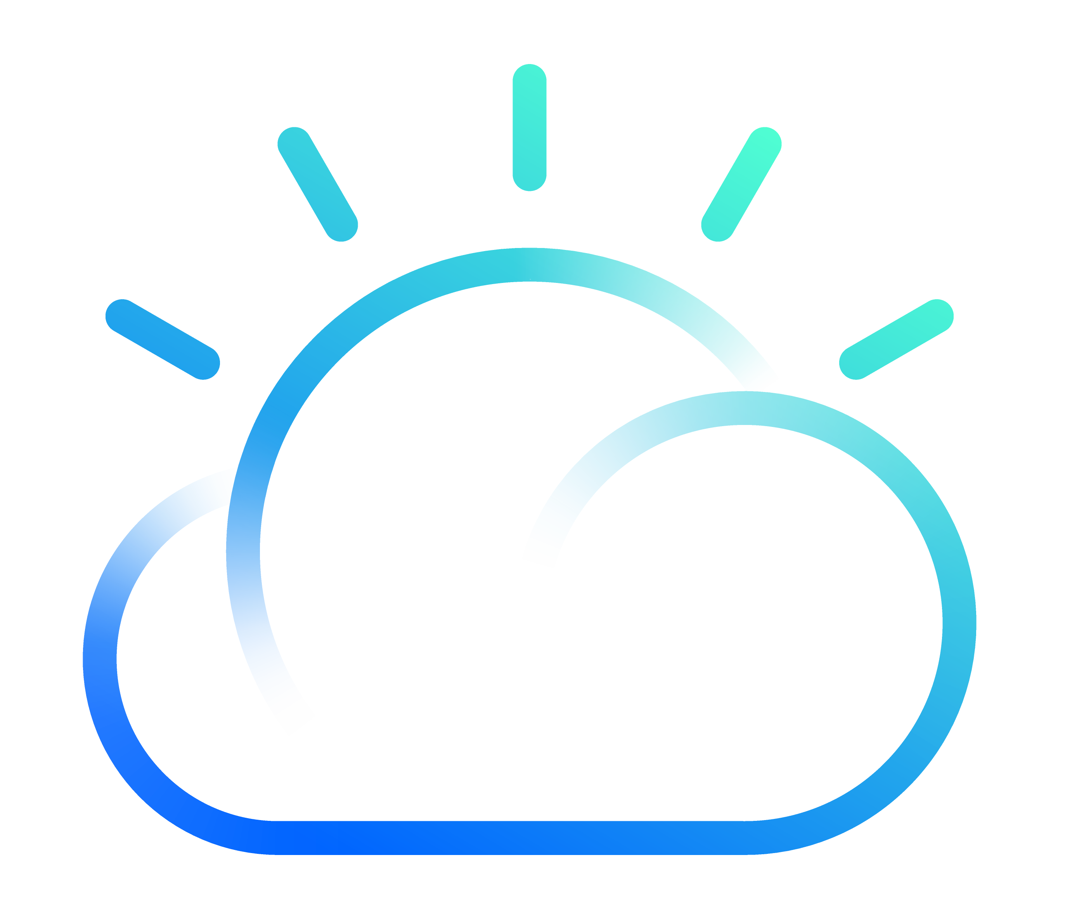
IBM Cloud
Ottmar Vargas Reyes
Cloud Platform Technical Seller
IBM Cloud Platform
ottmar.var@ibm.como

Slide 2
Agenda
¿qué es el cómputo en la nube?
¿Por qué ser native en la nube?
Capacidades
Centros de Datos
Servicios
Beneficios

Slide 3
¿Qué es el cómputo en la nube?
modelo de prestación de servicios de negocio y tecnología
permite acceso a un catálogo de servicios estandarizados
Permite responder de forma flexible y adaptativa, para demandas no previsibles o de picos de trabajo
pagar únicamente por el consumo efectuado, o incluso gratuitamente

Slide 4
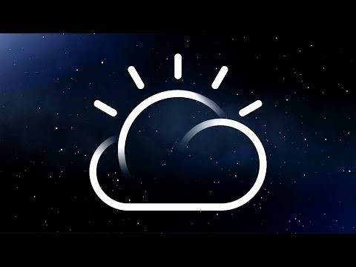
IBM Cloud es una nube de grado empresarial construida con el proposito de atender demanda intensiva de datos para Inteligencia Artificial y aplicaciones nativas en nube ejecutándose sobre infraestructura de próxima generación
Notes:
Reason we are pulling together as One IBM Cloud is so we can work together on selling our clients on this future vision, and THEN we can work with them on the steps to get there. If we only worry about the next step without selling them on the future vision, we risk them ending up on an island.

Slide 5
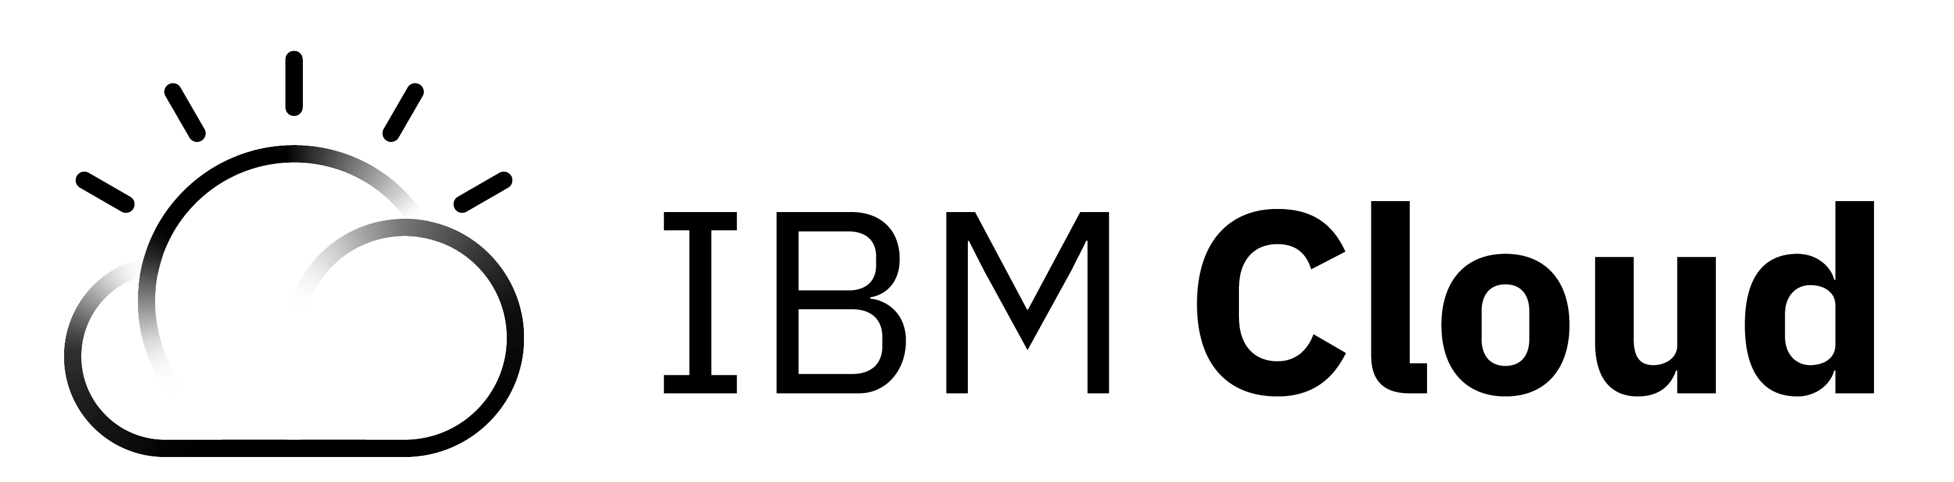
IBM Cloud - Servicios
Industria
IoT
Block Chain
Health
Financial
Services
Media
Discovery
Conver-sation
Natural Language
Speech & Vision
Tradeoff Analytics
Retrieve & Rank
Cognitivos
Datos & Análisis
Database
Data
Data Management
Analytics
Visualize
Messaging
Mobile
App Security
API & Integration
DevOps
Herramientas de Desarrollo
Containers
Cloud Foundry
Event-Driven
Run-Times
Compute
Storage
Network
Infraestructura
Virtual Servers
Bare Metal
VMware
Block
Object
File
Public
Private
VPN
CDN
Public
Dedicated
Local
Multi-Tenant
Single-Tenant
Single-Tenant
IBM Cloud
Client
Notes:
IBM Cloud Architecture
IBM Cloud is about solving clients’ data problems and helping them capitalize on transformative business opportunities that can be found in data – their own data, publicly available data, licensed data - data that is flowing by at a rate and pace that no single entity, no matter how large, can keep up with. So no matter what part of the portfolio we sell, we all need to be able to tell our clients that whole story of what IBM Cloud is and help them get to where they need to be, because this will be one of our real competitive differentiators. It doesn’t mean you have to be an analytics or AI or infrastructure expert, but we need to see where our specific specialty is part of a broader vision for addressing our clients’ biggest challenges and helping them capture their most compelling opportunities.

Slide 6






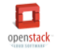

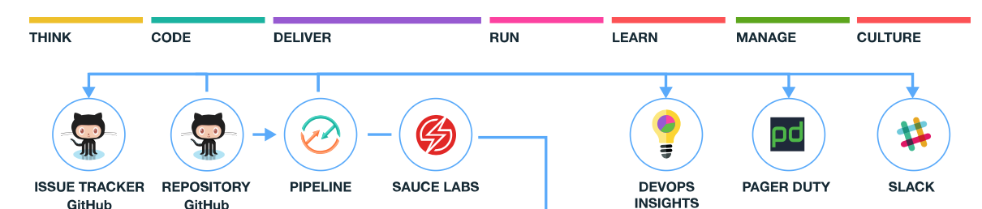
IBM Cloud – Beneficios
Opciones con consistencia
El entorno correcto para tú carga de trabajo
Elige cualquier opción para despliegue
Bare Metal
Virtual Server / VMware
Containers
CloudFoundry
Functions
Control y Desempeño
Portabilidad
Velocidad de Desarrollo
Estándares Abiertos
Evita casarte con una plataforma con estándares abiertos
Tecnologías de código abierto industrializado
Desarrollo con Productividad y Velocidad
Herramientas DevOps y Servicios
Los desarrolladores pueden usar cualquier leguaje
Innovación con servicios cognitivos
Amplio catálogo de servicios de IBM, terceros y Código abierto
Servicios Cognitivos, Analítica y Blockchain

Slide 7
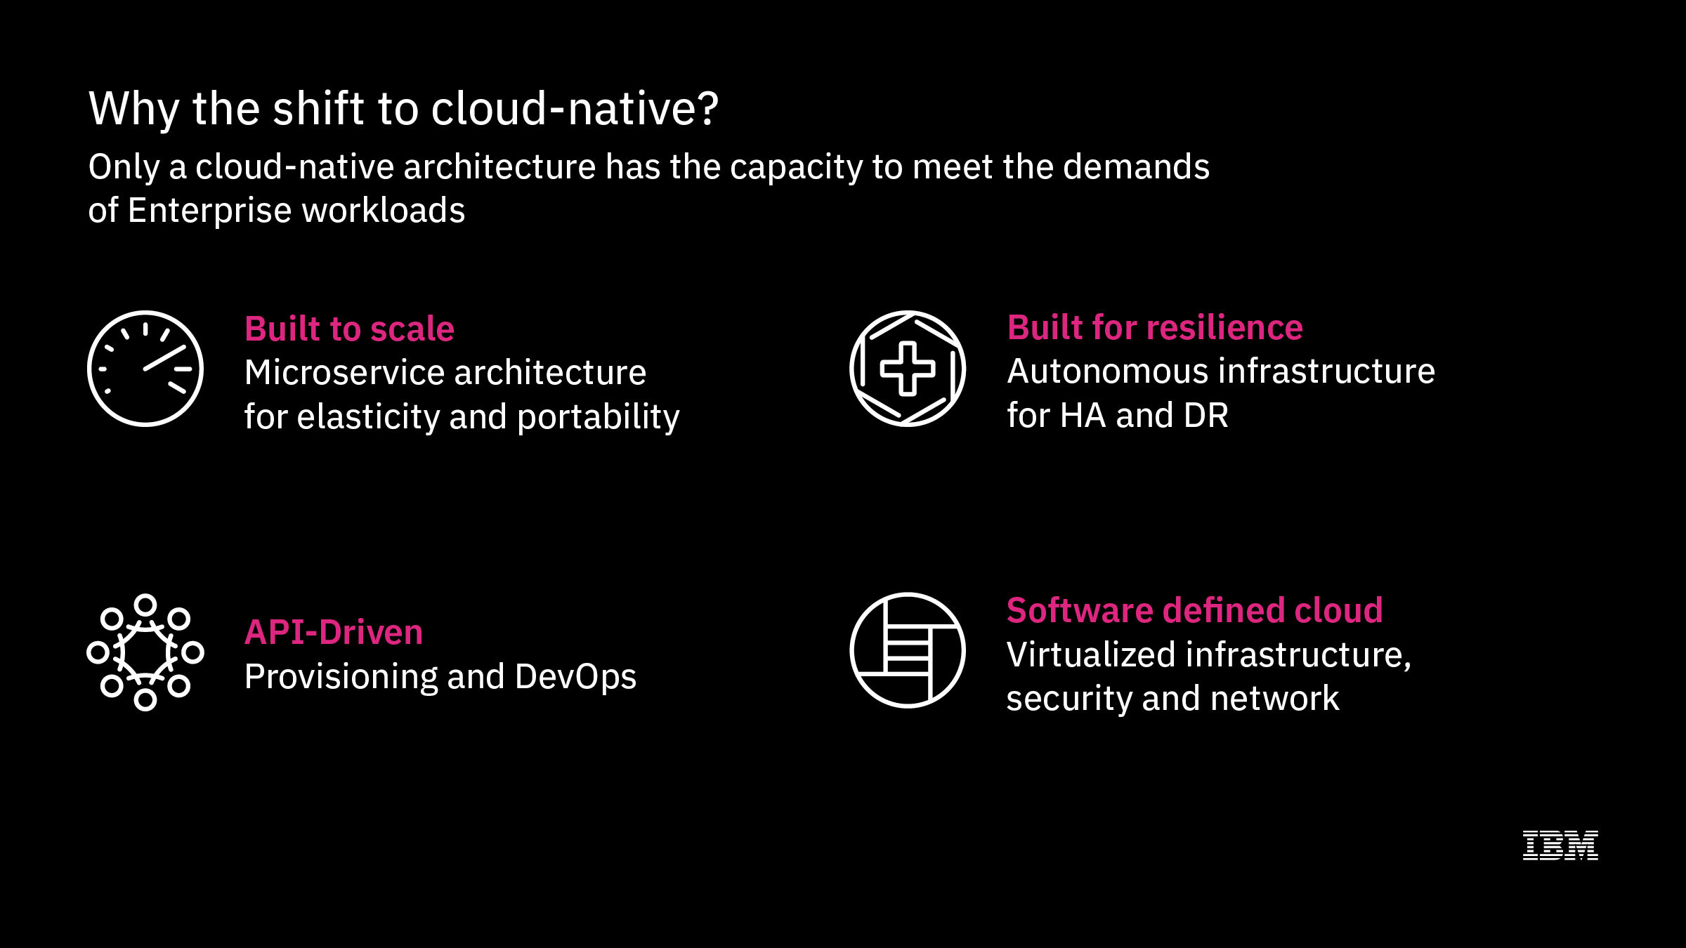
¿Por qué ser estar en la nube?
IBM Cloud tiene la capacidad de cumplir con las demandas de trabajo empresariales en aplicaciones nativas de nube
Escala
Arquitectura de microservicios para elasticidad y portabilidad
Resiliente
Infraestructura autonoma para alta disponibilidad y recurperación de desastres
Orientado a API
Aprovisionamiento y DevOps
Definida por Software
Infraestructura, seguridad y red virtualizada
Notes:
Cloud-native shift – gives you these things you can’t get on premises. Will talk about private and hybrid, but really going to cloud is more than where does server run. No private business can create infinite horizontal scale – no single business can replicate this. Data constantly increasing – we are all actually still losing ground in leveraging data – our ability to look at and understand constantly increasing volume is losing ground – only way to do this is to get your business onto a scalable platform that can leverage machine learning/deep learning, in a secure way.
Reason believe IBM can win – we are uniquely suited to get them on a path forward but only if we can sell them on this future state and get them to move to it so they can achieve greatness. If we only sell them something that works for them tomorrow, they will continue to fall farther and farther behind, and they will blame us.
Cloud native attributes
Throw this term around a lot and try to paint everything we do as this. But AWS and Microsoft are gonna help them understand and make us look like idiots and chipping away at our credibility because we are not being brave enough and bold enough to really say what we mean about Cloud-Native. It’s about building resiliency in – expecting the infrastructure to fail – building scalability in – so that application can self-heal, self-scale, self-grow – self-service.
Weather Company is perfect example of a business that auto-scales, resiliency built in – all on a public cloud (AWS today, but IBM Cloud migration is beginning now that we have a cloud capable of supporting that sort of business as a show-case).
Software defined cloud – spun up in automated fashion – no human intervention required.
What they’ve invested in VMWare wasn’t a waste – totally fit its purpose, we have to carry that forward, have to help them ride out that investment, that’s all OK. But moving a workload from on-prem, putting it in a container and running it on someone else’s infrastructure doesn’t get them all the benefits of cloud – that doesn’t make it cloud. We need to make sure our clients know we know that and can help them get to the true benefits of cloud.

Slide 8
¿Cómo llegar a la nube?

Slide 9
¿cómo empiezan las empresas en la nube?
1. Desarrollo Nativo en Nube
Recomendado para sistemas nuevos o sistemas monolíticos que necesitan renovación arquitectónica optimizando el uso de servicios en la nube pública de IBM, como Data, AI, Analytics, Blockchain, Mobile, Security, Weather, y más.
Innovación
2. Modernización de aplicaciones
Los contenedores pueden ayudar a mover las aplicaciones existentes a la nube, modernizarse utilizando las tecnologías de contenedor de IBM y desplegarse en nubes privadas o públicas y moverse fácilmente entre ellas.
3. Migración de Cargas
Migrar las cargas de trabajo existentes a la nube como primer paso para transformar y modernizar sus aplicaciones empresariales con alianzas de IBM: VMWare, SAP HANA, Cómputo de Alto Rendimiento, Servidores Power
Eficiencia Operativa
4. Administración de datos y resiliencia
Las estrategias de recuperación de desastres en la nube pueden ayudar al proporcionar centros de datos disponibles en todo el mundo para respaldar sus bases de datos y aplicaciones para garantizar que sus clientes noten una interrupción mínima

Slide 10
IBM Cloud – Desarrollo Nativo en Nube
1. Desarrollo Nativo en Nube
Recomendado para sistemas nuevos o sistemas monolíticos que necesitan renovación arquitectónica optimizando el uso de servicios en la nube pública de IBM, como Data, AI, Analytics, Blockchain, Mobile, Security, Weather, y más.
3. Modernización de aplicaciones
Los contenedores pueden ayudar a mover las aplicaciones existentes a la nube, modernizarse utilizando las tecnologías de contenedor de IBM y desplegarse en nubes privadas o públicas y moverse fácilmente entre ellas.
Los contenedores a diferencia de las máquinas virtuales comparten más recursos: infraestructura y sistema operativo
Maquinas Virtuales
Contenedores
Sistema operativo individual
Infraestructura dedicada a soportar la VM
Sistema operativo compartido
Infraestructura compartida y usada bajo demanda
Características adicionales: resiliencia, escalamiento horizontal, balanceo

Slide 11
Incursionar en Cloud Native puede parecer un camino confuso pero sugerimos los siguientes recursos de aprendizaje para comenzar a abordar los temas generales que involucra
Fundamentos de IBM Cloud
Entornos de Ejecución
Contenedores
Docker
Cloud Foundry
Kubernetes
Serverless
Arquitectura de Microservicios
API Rest
DBaaS
Internet of Things
Artificial Intelligence
Watson Services
Data Science
Blockchain
DevOps
Revisa el documento adjunto
Notes:
Reason we are pulling together as One IBM Cloud is so we can work together on selling our clients on this future vision, and THEN we can work with them on the steps to get there. If we only worry about the next step without selling them on the future vision, we risk them ending up on an island.

Slide 12
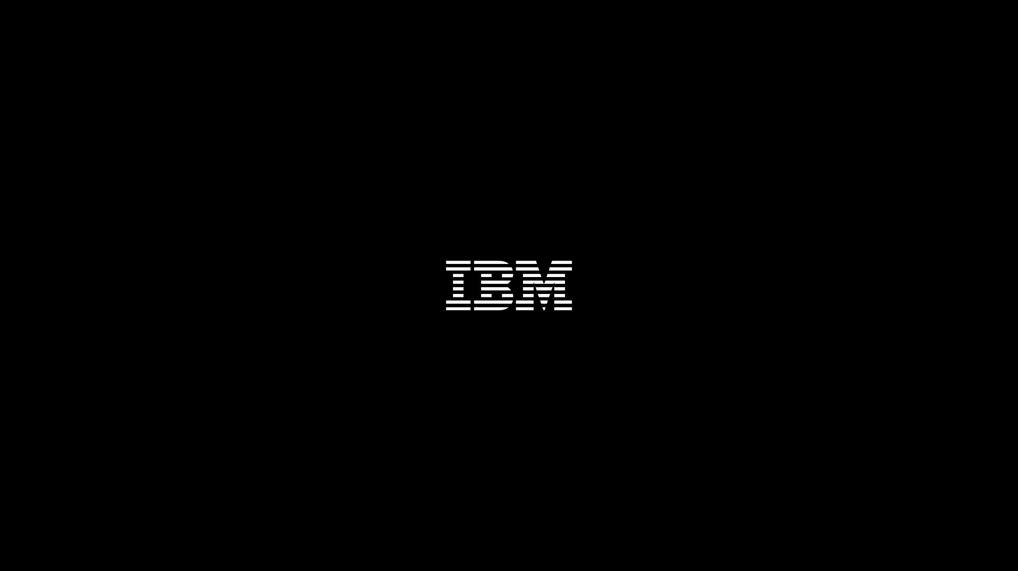
www.ibm.com/w3-techblog
Notes:
TechBlog:
Last thing – we are literally doing releases every day…and it’s going to get faster. Work we did in the last 12 months was great – but I am telling my team – we have to do that much in the next 3. That’s how much faster we have to get. So Techblog was put together as the place of truth – a lot of folklore in IBM – Techblog is meant to be the official source of record, source of truth for roadmaps and plans…Slack is NOT an official system of record. It’s a great place to communicate. But it is not a source of commitments.

Slide 13
Please Note
IBM’s statements regarding its plans, directions, and intent are subject to change or withdrawal without notice at IBM’s sole discretion.
Information regarding potential future products is intended to outline our general product direction and it should not be relied on in making a purchasing decision.
The information mentioned regarding potential future products is not a commitment, promise, or legal obligation to deliver any material, code or functionality. Information about potential future products may not be incorporated into any contract. The development, release, and timing of any future features or functionality described for our products remains at our sole discretion.
Performance is based on measurements and projections using standard IBM benchmarks in a controlled environment. The actual throughput or performance that any user will experience will vary depending upon many factors, including considerations such as the amount of multiprogramming in the user’s job stream, the I/O configuration, the storage configuration, and the workload processed. Therefore, no assurance can be given that an individual user will achieve results similar to those stated here.

